Slide 1
Focusing of the National Support Programme of the Czech Republic in 2013
Sub-programme
Tourism for All (EuroVelo 13 Iron curtain trail)

Slide 2
Orientation of the sub-programme:
Support of the development of domestic tourism, especially through the development of rest areas and sanitary facilities along trails - Euro-Velo, Rand pathways,
Making tourist attractions more accessible,
Support of ecological forms of tourism and transport (e.g. bicycles, small trains for excursions, environmentally-friendly water transport, etc.).

Slide 3
Preferred target groups:
children (up to 15 years old),
families with children,
persons with disabilities,
senior citizens.

Slide 4
Objectives of the sub-programme:
The integration of new target groups, for which participation in tourism is difficult, into tourist activities,
Maintaining employment in tourism, in light of the current economic situation of the Czech Republic,
Ensuring conditions for the improvement of tourism infrastructure (e.g. improving the availability of services along pedestrian and bicycle pathways),
Making tourist attractions more accessible (implementation of ecological forms of transport, ensuring barrier-free access points).

Slide 5
Justification of applicants 2013
:
Business subjects (legal entities and businesspeople)
A grant applicant must show, at least, two years of entrepreneurial history (2011,2012)

Slide 6
Allocation of the sub-programme:
50 mil. CZK in 2013
Principles governing grants:
individual projects,
grants may cover up to 50% of the overall allowable expenses for an activity, the recipient shall pay the remaining expenses,
overall expenditures for one activity can extend up to 5 mil. CZK.

Slide 7
Implementation of an activity:
The grant must be completely utilised during the year it is awarded,
The activity that will be co-financed within the sub-programme must be completed, at latest, during the year following its selection as a grant-winning project.
(i.e. Activities selected in 2013 must be finished, at latest, by the end of 2014.)

Slide 8
Objectives for the implementation of this year’s National Programme:
Include improving the quality and availability of services for all potential participants in tourism,
fully equipping the existing state of, especially, pedestrian trails, cycling paths, educational trails and hiking destinations (with places for tourists to rest, barrier-free WCs, etc.).
making sites accessible for residents with disabilities (environmentally-friendly transport, barrier-free access points, equipment to aid persons with disabilities, e.g. visual navigation and audio).

Slide 9
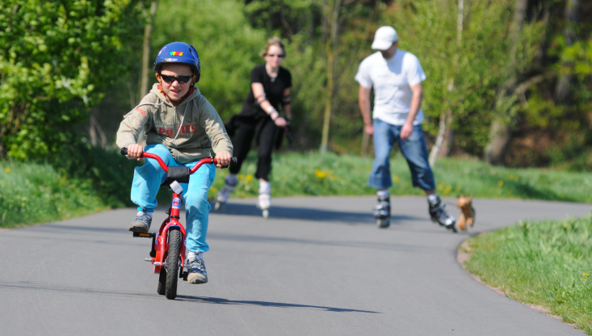
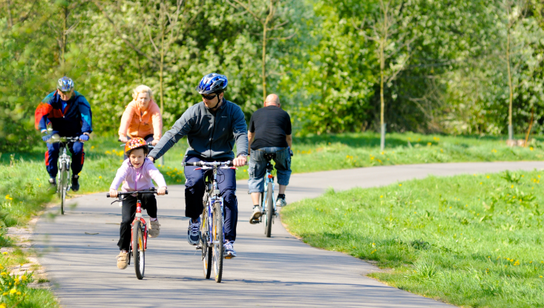
Examples of best practices:
Adding a full complement of services along bicycle paths in places of concentrated tourist use.

Slide 11
Information on the sub-programme shall be presented at:
The Ministry for Regional Development’s website:
http://www.mmr.cz/Cestovni-ruch/Programy-Dotace
After announcing the grant competition, seminars will be held concerning the topic in question.
The Division of Tourism is the contact point.

Slide 12
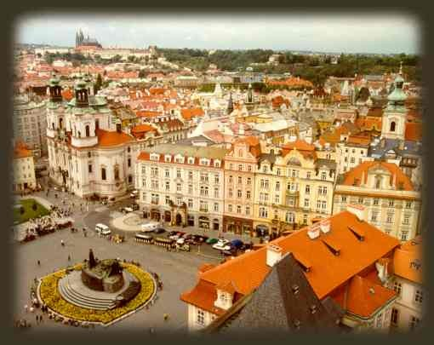
Ing. Rostislav Hošek
Division of Tourism
Staroměstské nám. 6
110 15 Prague 1
www.mmr.cz

